Slide 1
Mindreading & Joint Action
Mindreading & Joint Action
5. Actions, Intentions & Goals
butterfillS@ceu.hu
butterfillS@ceu.hu

Slide 2
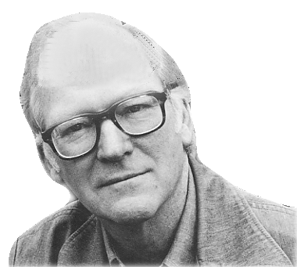
What events in the life of a person reveal agency; what are his deeds and his doings in contrast to mere happenings in his history; what is the mark that distinguishes his actions?

Slide 3
“What events in the life of a person reveal agency; what are his deeds and his doings in contrast to mere happenings in his history; what is the mark that distinguishes his actions?”
“a person is the agent of an event if and only if there is a description of what he did that makes true a sentence that says he did it intentionally”
(Davidson 1971: 46)

